Slide 1
Workshop 8 – Deep Learning – Part 3
Advanced Analytics and Applications [AAA]
Information Systems for Sustainable Society (is3) | WiSo Faculty | Univ.-Prof. Dr. Wolfgang Ketter | 5/26/20

Slide 2
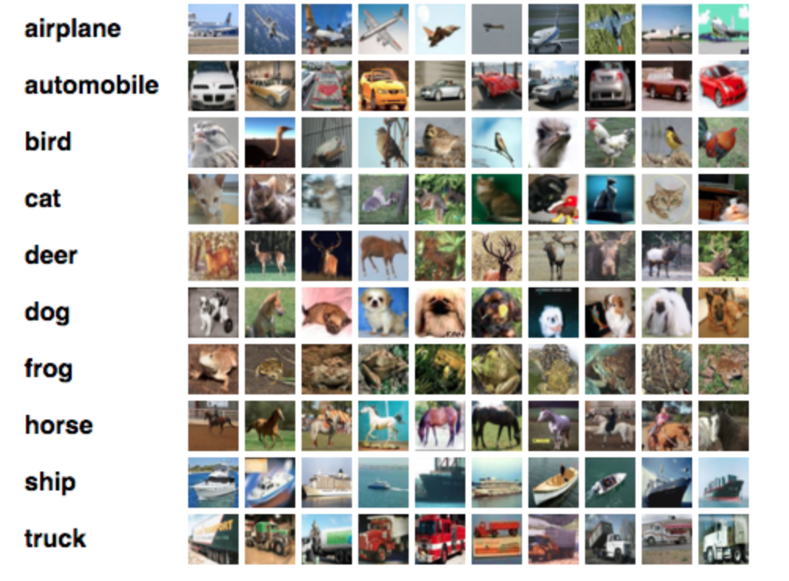
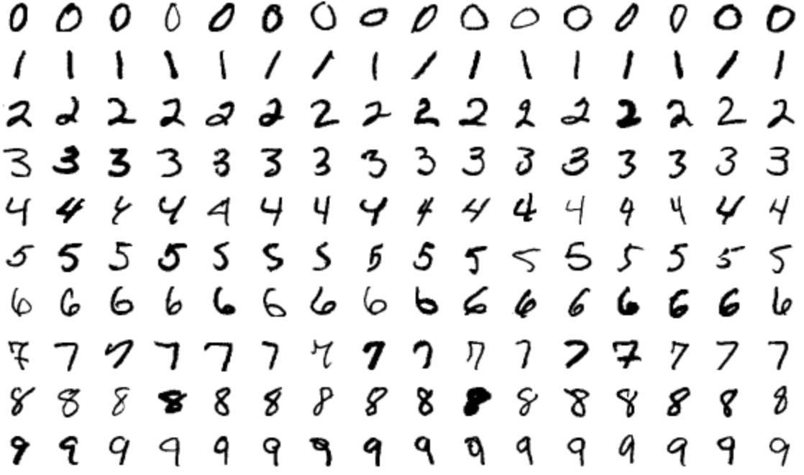
Deep Learning
Today‘s topics
1
Regularization Techniques
2
Hand-Written Digits
3
Image Classification
https://towardsdatascience.com/text-classification-in-keras-part-1-a-simple-reuters-news-classifier-9558d34d01d3
https://medium.com/rocknnull/playing-with-machine-learning-a-practical-example-using-keras-tensorflow-790375cd1abb

Slide 3
Deep Learning
Developing an advanced cnn to classify images
Loss: categorical_crossentropy
Metrics: ‘accuracy’
Optimizer: ‘adam’ (or sdg)
P
P
0.25
0.25
C
D
D
C
C
Conv. Only
Layer 1
Conv.
Layer 2
Dropout
Conv.
Layer 2
Dropout
Flatten
Dense Network
Output
Input with 32x32x3
SoftMax, 10 Output nodes
Filters: 50 Kernel: (3,3) Strides: (1,1) Padding: ‘same’ Act: ReLU
Filters: 50 Kernel: (3,3) Strides: (1,1) Padding: ‘same’
Act: ReLU MaxPooling: (2,2)
Filters: 125 Kernel: (3,3) Strides: (1,1) Padding: ‘same’
Act: ReLU MaxPooling: (2,2)
2 Layers
Dropout after each layer with dr=0.4
500 nodes first hidden layer,
250 nodes second hidden layer
ReLU Activation
https://towardsdatascience.com/text-classification-in-keras-part-1-a-simple-reuters-news-classifier-9558d34d01d3
https://medium.com/rocknnull/playing-with-machine-learning-a-practical-example-using-keras-tensorflow-790375cd1abb

Slide 4
Contact
For general questions and enquiries on research, teaching, job openings and new projects refer to our website at www.is3.uni-koeln.de
For specific enquiries regarding this course contact us by sending an email to the IS3 teaching address at is3-teaching@wiso.uni-koeln.de

